Slide 1



GRADUATION PROJECT 2026
Analyzing Unemployment via Neural Networks
Case Study: Jordan & Selected Arab Countries
Prepared by
Supervised by
Ayham Altamimi
Prof. Ayman Mansour

Slide 2


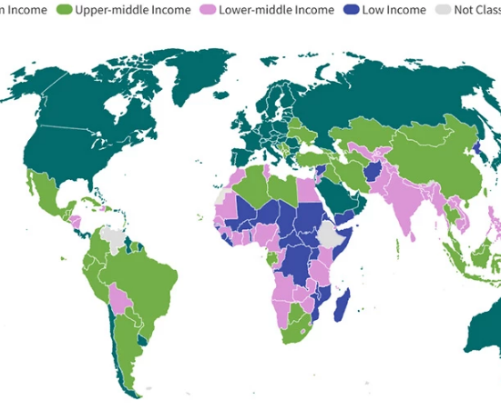
PROJECT BACKGROUND
Global & Regional Shift
Unemployment is a multi-dimensional socio-economic challenge, especially in the MENA region. Jordan faces unique volatility due to geopolitical and economic shifts.
Traditional theories (Okun's Law) provide a baseline, but modern volatility requires Business Intelligence and AI to capture hidden non-linear patterns.

Slide 3






THE PROBLEM STATEMENT
Model Limitations
Data Complexity
Strategic Gap
Traditional statistical models (like OLS) fail to account for non-linear shifts in technology and trade.
Standard models cannot efficiently process 65 years of diverse indicators (21 variables) with high precision.
A critical need exists for an AI-driven framework to provide "Actionable Insights" for Jordanian policymakers.

Slide 4
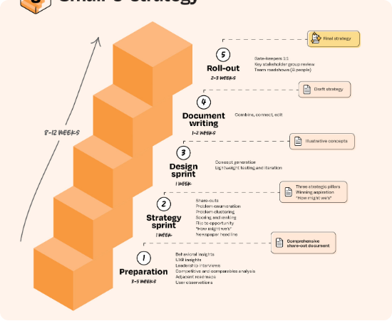
RESEARCH OBJECTIVES
Identify the most significant economic indicators affecting Jordan.
Design an Artificial Neural Network (ANN) for precise forecasting.
Evaluate the role of High-Tech and ICT exports in labor market resilience.
Propose the SAIEF Strategic Framework for decision-makers.

Slide 5

CORE HYPOTHESES
H1: Tech-Led Resilience
H2: AI Superiority
Non-linear relationship exists between technological adoption (ICT exports) and unemployment reduction.
ANN models achieve significantly higher predictive accuracy compared to traditional linear statistical models.

Slide 6

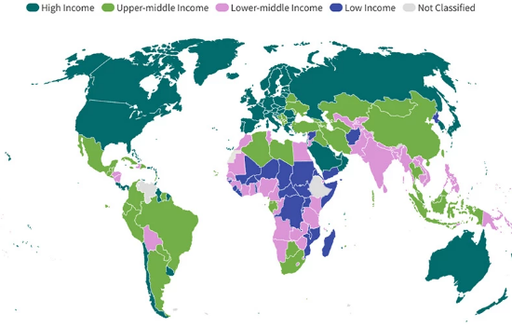
DATA SOURCES & SCOPE
The Dataset
•
Source: World Bank Open Data (1960–2025).
•
Timeline: 65 years of longitudinal historical records.
•
Geography: Jordan (Focus) + Egypt, Lebanon, Morocco, Tunisia.
•
Variables: 21 Independent features.

Slide 7
THE 21 ECONOMIC INDICATORS
Cluster | Key Indicators | Rationale
Macro-Stability | GDP Growth, Inflation (CPI), FDI | Overall economic health and shocks.
Trade & Tech | High-Tech Exports, ICT Services | Knowledge-based economy drivers.
Social/Human | Edu. Expenditure, Population Growth | Workforce quality and demographic pressure.
Labor Market | LFPR, Youth/Female Unemployment | Structural demographics of target variable.

Slide 8
RESEARCH METHODOLOGY
Data Ingestion
Preprocessing
ANN Design
BI Layer
Extracting from World Bank (CSV/Excel)
Cleaning, Imputation & Scaling
64-32 Neuron Hidden Layers
Visualization in Power BI

Slide 9

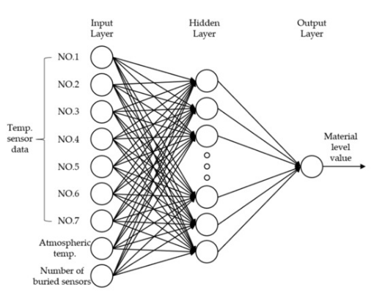
AI PART: ANN ARCHITECTURE
Multi-Layer Perceptron
Architecture: 21-64-32-1 Topology.
•
Input: 21 Economic neurons.
•
Hidden 1 (64): Macro-trend detection.
•
Hidden 2 (32): Synergistic pattern mapping.
•
Output (1): Predicted Unemployment.
Activation: ReLU | Optimizer: Adam

Slide 10




DATA PRE-PROCESSING
Min-Max Normalization
Scaling variables to a uniform range of [0, 1] to prevent "Magnitude Bias" (e.g., GDP vs % Inflation).
Handling missing values using Mean Imputation & Interpolation.

Slide 11






MODEL OPTIMIZATION
Software Stack
Train-Test Split
Hyperparameters
Python 3.10 | TensorFlow | Keras | Scikit-learn
80% Training (Learning patterns) | 20% Testing (Generalization)
100 Epochs | Batch Size: 32 | Learning Rate: Adaptive

Slide 12

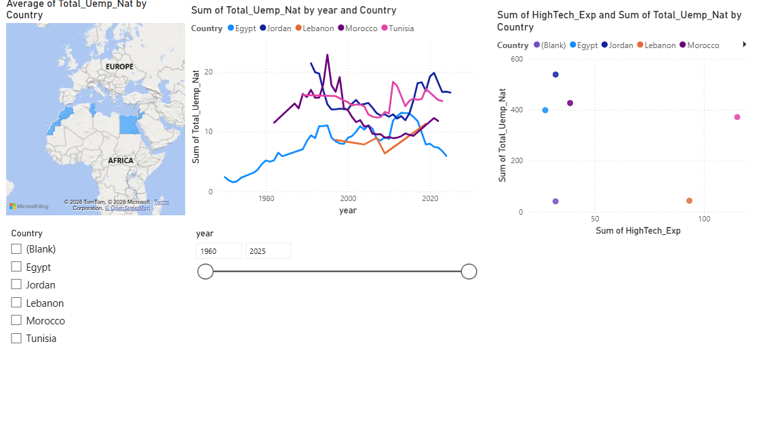
BI SYSTEM DESIGN
Power BI Integration
The system transforms complex ANN outputs into a visual Decision Support System (DSS).
Includes interactive maps for regional comparison, trend slicers for historical analysis, and correlation heatmaps for feature discovery.
Descriptive clarity
Predictive intelligence

Slide 13

INTERACTIVE DASHBOARD
Visual Evidence
•
Geospatial Map: Tracks regional hotspots.
•
Time-Series: Monitors shocks from 1960-2025.
•
Scatter Plot: Tech Exports vs Unemployment.
"The dashboard enables policymakers to perform 'What-If' scenarios based on our AI weights."

Slide 14
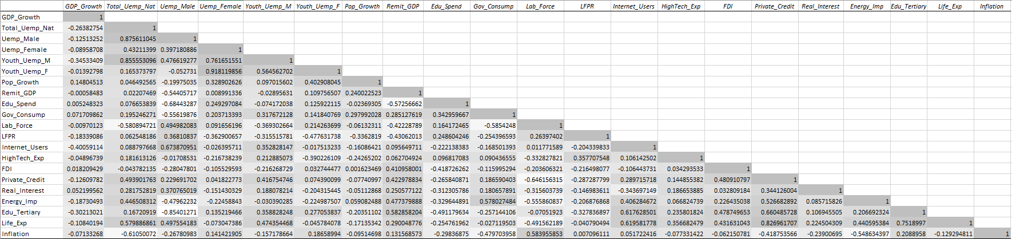

EXPLORATORY INSIGHTS
The Heatmap Analysis
Correlation Discovery revealed:
Strong link between Internet Usage and ICT Exports.
Inverse relationship between High-Tech exports and Unemployment.
Structural mismatch found in Education clusters.

Slide 15

PREDICTIVE RESULTS
Exceptional Performance
79.87%
The model explains nearly 80% of the variance in unemployment trends. In macroeconomics, this is considered highly robust.
•
MAE: 0.0369 (Near-zero deviation)
R-Squared Accuracy
•
Reliability: Consistent across 100 epochs
•
Generalization: Validated on unseen testing data

Slide 16


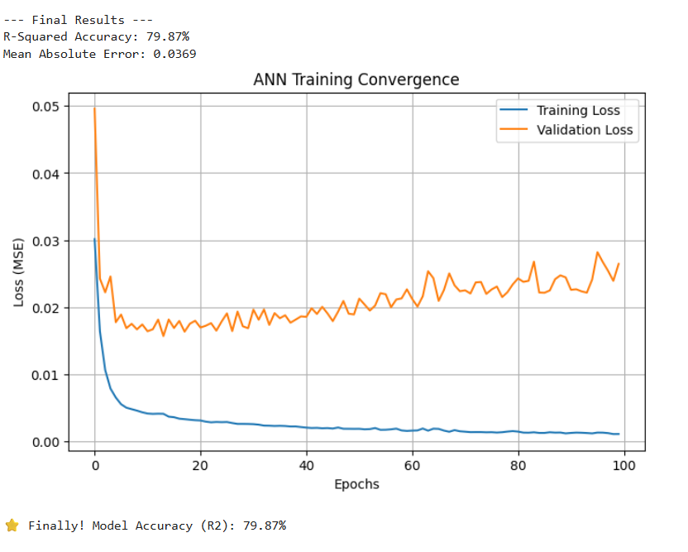

MODEL CONVERGENCE
MSE Loss Curve: Training vs. Validation Loss showing stable convergence without overfitting.

Slide 17
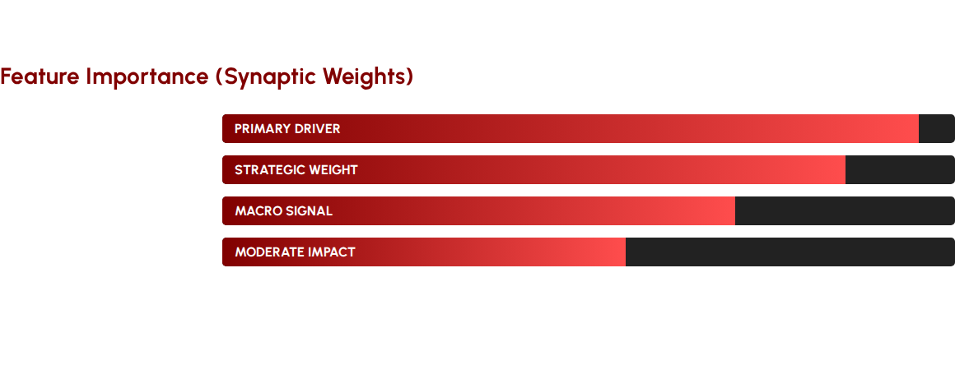
THE "HIGH-TECH" LEVER
Discovery: Jordan's shift toward tech-exports is the most effective lever for reducing unemployment spikes.

Slide 18




THE SAIEF FRAMEWORK
Pillar I
Pillar II
Pillar III
Predictive Monitoring: Real-time integration of ANN into policy cycles.
Visual Analytics: Government BI Dashboards for transparency.
Dynamic Policy: 'What-If' simulations for targeted funding.

Slide 19

CONCLUSION
Key Takeaways
1. Unemployment is non-linear; AI (ANN) is essential for precision.
Vision 2033 Alignment
2. Technology industrialization is the catalyst for economic transformation.
Data-Driven Governance
3. Transitioning from Descriptive to Predictive analytics is Jordan's path forward.

Slide 20
Thank You!
Questions & Discussion
Prepared by: Ayham Altamimi
Supervised by: Prof. Ayman Mansour
https://github.com/ayhamaltamimiofficial/GP_BI20252
Ayham Altamimi University of Petra

Slide 21





IMAGE SOURCES
https://upload.wikimedia.org/wikipedia/commons/thumb/2/2f/Treasury_petra_crop.jpeg/1280px-Treasury_petra_crop.jpeg
Source: en.wikipedia.org
https://s7d1.scene7.com/is/image/wbcollab/Income-Level-map?qlt=90&fmt=webp&resMode=sharp2
Source: blogs.worldbank.org
https://substackcdn.com/image/fetch/f_auto,q_auto:good,fl_progressive:steep/https%3A%2F%2Fsubstack-post-media.s3.amazonaws.com%2Fpublic%2Fimages%2F2314d431-64dd-41af-9c52-905c4d5722a0_1457x1461.jpeg
Source: www.lennysnewsletter.com
https://www.mdpi.com/sensors/sensors-21-04427/article_deploy/html/images/sensors-21-04427-g005-550.jpg
Source: www.mdpi.com
https://media.istockphoto.com/id/2174607489/vector/outline-icons-set-depicting-data-refinement-data-removal-error-correction.jpg?s=612x612&w=0&k=20&c=Mlh8WNIzP2O8sPTrmQYp6rYb57vHZTA6q1_wYkz_S8E=
Source: www.istockphoto.com

Slide 22

IMAGE SOURCES
https://elements-resized.envatousercontent.com/elements-video-cover-images/b7ef5529-5f36-4d1a-8eaa-95f9b8ff130c/video_preview/video_preview_0000.jpg?w=500&cf_fit=cover&q=85&format=auto&s=5036ba6743f103381e0e5657889d77e37bd6917b110a52c02f21c354ea535fe5
Source: elements.envato.com

